Slide 1

Adjusting financial statements
Unit 4
BU7313 Financial Modelling & Scenario Analysis
Prof Gerhard Kling University of Aberdeen

Slide 2
AGENDA: Unit 4
Operating leases
Off-balance-sheet items
Impact on EPS and ROA
Adjustment to NOPLAT and IC
Pension liabilities
Defined benefit plans
Pension liabilities and assets
Required adjustments
Provisions and reserves
Income-smoothing
Amortization
Restructuring charges
Kellogg revisited
Operating leases
Other adjustments

Slide 3
Contents
Operating leases
Pension liabilities
Provisions and reserves
Kellogg revisited

Slide 4
What are operating leases?
Assume that a firm owns an operating asset (e.g. store) which has a value of say GBP 200 million
This asset is disclosed on the balance sheet as part of Net PP&E and needs to be financed by debt or equity (we assume debt finance)
The firm decides to sell the asset for GBP 200 million to another company (lessor) and rents it back
The firm can use the proceeds to reduce its debt by GBP 200 million, which in turn reduces interest expenses
However, the firm now has to pay rent to the lessor
The lessor needs to get compensated for depreciation of the asset and financing costs
Why would anyone do that?

Slide 5
Alleged benefits of operating leases
This transaction can be classified (under certain conditions) as an operating lease
Hence, the asset of GBP 200 million disappears from the balance sheet, i.e. invested capital (or total assets) decline by GBP 200 million
Moreover, debt is reduced, which improves financial leverage defined as debt/equity
However, the firm did not change its actual operations, it only changed the legal ownership of the asset
As we will see, operating leases do affect earnings per share (EPS) and return on assets (ROA) as companies look “asset light”
To understand real value creation, we need to adjust for operating leases

Slide 6
Operating leases can distort the picture
Number of stores (2002)
Stores leased
Stores owned*
100% =
ROIC (2002)
Target
1,475
No lease adjustment
With lease adjustment
Kohls
457
Target
Lease payment in percent of profits (2002)
Kohls
Target
Range = 6.5%
Range = 2.2%
Kohls

Slide 7
Let’s consider an example: Tricky Inc’s accounting adventure
 | Today | Year 1 | Year 2 | Year 3 |  |  | Today | Year 1 | Year 2 | Year 3
Revenues | 1,000 | 1,070 | 1,145 | 1,225 |  | Short-term assets | 250 | 268 | 286 | 306
Expenses | -900 | -963 | -1,030 | -1,103 |  | Long-term assets | 580 | 621 | 664 | 711
Renal expenses |  |  |  |  |  | Operating assets | 830 | 888 | 950 | 1,017
EBIT | 100 | 107 | 114 | 123
Interest expenses | -17 | -16 | -16 | -15 |  | Operating liabilities | 150 | 161 | 172 | 184
Earning before taxes | 84 | 91 | 99 | 107 |  | Debt | 330 | 323 | 315 | 306
Taxes | -29 | -32 | -35 | -38 |  | Equity | 350 | 404 | 463 | 527
Net income | 54 | 59 | 64 | 70 |  | Liabilities & equity | 830 | 888 | 950 | 1,017
EPS | 0.543 | 0.590 | 0.642 | 0.697
ROA | 6.54% | 6.65% | 6.75% | 6.85%
Assumption
Growth | 7%
Tax rate | 35%
Cost of debt | 5%
Exp/Rev | 90%
Number of shares | 100 | >>> million

Slide 8
… and after operating leases
 | Today | Year 1 | Year 2 | Year 3 |  |  | Today | Year 1 | Year 2 | Year 3
Revenues | 1,000 | 1,070 | 1,145 | 1,225 |  | Short-term assets | 250 | 268 | 286 | 306
Expenses | -890 | -952 | -1,019 | -1,090 |  | Long-term assets | 380 | 407 | 435 | 466
Renal expenses | -20 | -21 | -23 | -25 |  | Operating assets | 630 | 674 | 721 | 772
EBIT | 90 | 96 | 103 | 110
Interest expenses | -7 | -5 | -4 | -3 |  | Operating liabilities | 150 | 161 | 172 | 184
Earning before taxes | 84 | 91 | 99 | 107 |  | Debt | 130 | 109 | 86 | 61
Taxes | -29 | -32 | -35 | -38 |  | Equity | 350 | 404 | 463 | 527
Net income | 54 | 59 | 64 | 70 |  | Liabilities & equity | 630 | 674 | 721 | 772
EPS | 0.543 | 0.590 | 0.642 | 0.697
 |  |  |  |  |  | Operating lease
ROA | 8.62% | 8.76% | 8.90% | 9.03% |  |  | Today | Year 1 | Year 2 | Year 3
 |  |  |  |  |  | Amount | 200 | 214 | 229 | 245
 |  |  |  |  |  | Years of use | 20
Assumption |  |  |  |  |  | Rent in % | 10.00%
Growth | 7%
Tax rate | 35%
Cost of debt | 5%
Exp/Rev | 90%
Number of shares | 100 | >>> million

Slide 9
In this example, Tricky Inc reduces its debt level
Operating assets decline
No change in number of shares outstanding as there is no buy back of shares
Net income does not change as items are only shifted
Expenses reduced as deprecation of asset is covered by lessor
Interest expenses reduced as debt declines
But rental expenses added which are equal to the two reductions
Earning per share (EPS) unchanged by return on assets (ROA) improves
Does this mean that the firm generates more value?

Slide 10
The ROA “miracle”
Profitability seems to increase by 31.75%

Slide 11
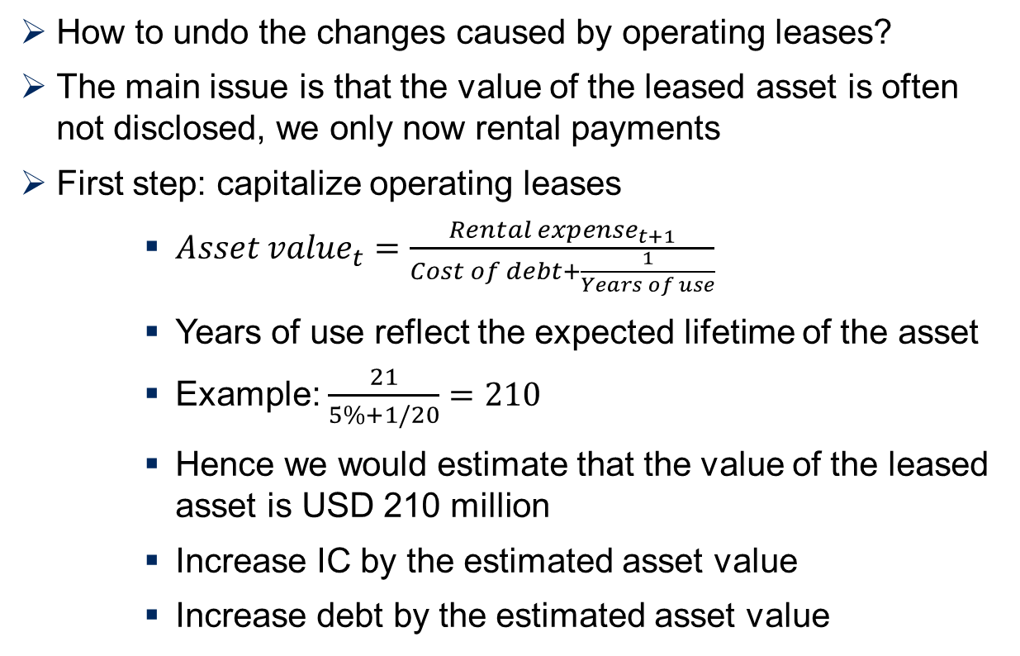
Adjusting for operating leases I
How to undo the changes caused by operating leases?
The main issue is that the value of the leased asset is often not disclosed, we only now rental payments
First step: capitalize operating leases
${Asset value}_{t}=\frac{{Rental expense}_{t+1}}{Cost of debt+\frac{1}{Years of use}}$
Years of use reflect the expected lifetime of the asset
Example: $\frac{21}{5\%+1/20}=210$
Hence we would estimate that the value of the leased asset is USD 210 million
Increase IC by the estimated asset value
Increase debt by the estimated asset value

Slide 12
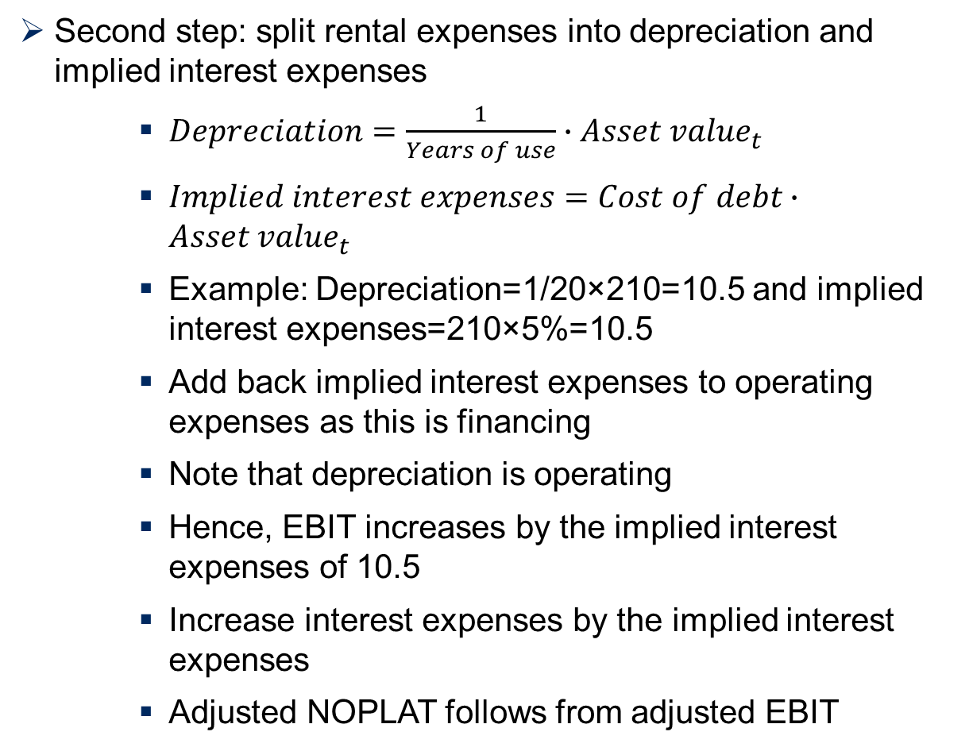
Adjusting for operating leases II
Second step: split rental expenses into depreciation and implied interest expenses
$Depreciation=\frac{1}{Years of use}∙{Asset value}_{t}$
$Implied interest expenses=Cost of debt∙{Asset value}_{t}$
Example: Depreciation=1/20×210=10.5 and implied interest expenses=210×5%=10.5
Add back implied interest expenses to operating expenses as this is financing
Note that depreciation is operating
Hence, EBIT increases by the implied interest expenses of 10.5
Increase interest expenses by the implied interest expenses
Adjusted NOPLAT follows from adjusted EBIT

Slide 13
Debt equivalents
Operating leases are treated as a debt equivalent
Hence, levels of debt are adjusted with capitalized operating lease, i.e. the asset value
The value of equity reflects these debt equivalents as the entity value is reduced in line with adjustments to debt
One could determine adjusted financial leverage (see lecture on financial health)
In addition, other ratios such as interest coverage need to be adjusted as actual interest expenses are hidden in rental payments
There are implications for cost of capital (WACC)

Slide 14
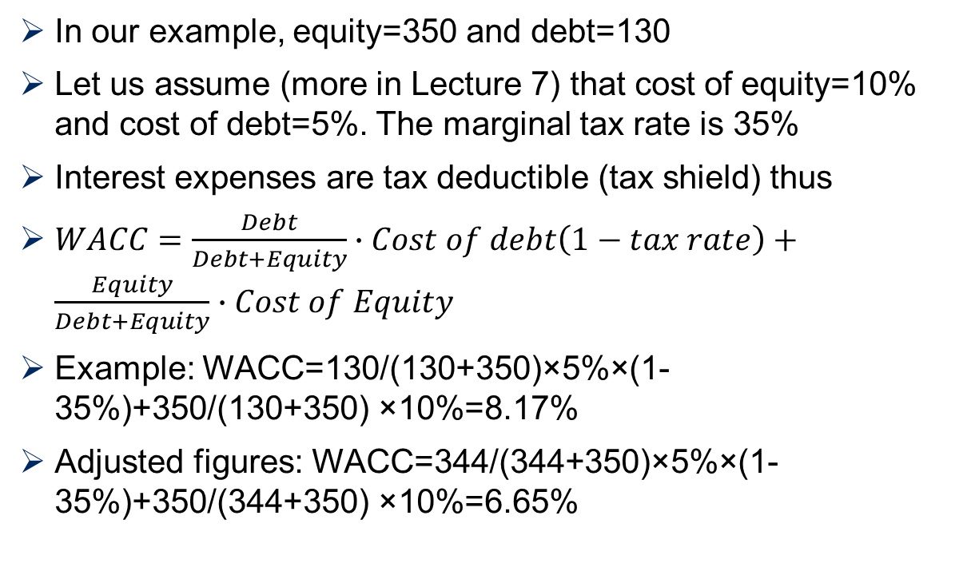
Adjusting WACC
In our example, equity=350 and debt=130
Let us assume (more in Lecture 7) that cost of equity=10% and cost of debt=5%. The marginal tax rate is 35%
Interest expenses are tax deductible (tax shield) thus
$WACC=\frac{Debt}{Debt+Equity}∙Cost of debt\left(1−tax rate\right)+\frac{Equity}{Debt+Equity}∙Cost of Equity$
Example: WACC=130/(130+350)×5%×(1-35%)+350/(130+350) ×10%=8.17%
Adjusted figures: WACC=344/(344+350)×5%×(1-35%)+350/(344+350) ×10%=6.65%

Slide 15
Contents
Operating leases
Pension liabilities
Provisions and reserves
Kellogg revisited

Slide 16
Promised retirement benefits
Historically, employees have received defined benefit plans for their retirement, i.e. benefits are guaranteed by employers
These future obligations are offset with assets (contributions of both employees and employers are invested in assets)
However, pension liabilities often exceed assets due to higher life expectancy and low interest rates
Unfortunately, changes in pensions such as interest expenses or gains/losses on investments are included in operating expenses (i.e. COGS and SGA)
Hence, pension changes affect our measurement of NOPLAT and pension assets/liabilities also distort invested capital (IC)

Slide 17

Pensions can have a huge impact on profit margins
Percent
As reported
With pension adjustment

Slide 18
Adjustment to invested capital and entity value
Identify unfunded liabilities and excess pension assets which can be on the balance sheet (separate items) or in the notes of financial statements
Pension related assets are not operating and not in IC
Example: Smithfield Food reported in 2012 a net long-term pension liability (liabilities minus assets) of USD 582 million
Our valuation model did not realise this net liability, which is a debt equivalent
It needs to be deducted from the entity value to derive an adjusted value of equity
Before adjustment we derived a value of equity of USD 5,196 million or a fundamental share price of USD 36.2
Recognising the pension liability reduces the value by 582/5,196=11.2%
Hence, pension liabilities are worth USD 4 per share!

Slide 19
Adjustment to NOPLAT
Identify and remove the accounting pension expense from COGS and / or SGA
Add instead the service cost and (in the case of benchmarking see next lecture) add the amortization of prior service costs
Company’s notes to financial statements report these items
Example: Smithfield Food reported in 2012 a service cost
The service cost of USD 37.4 million is an operating expense (staff cost)
However, the firm includes period costs of USD 57.2 million, which include interest cost (financing)
Hence, add back USD 19.8 million to operating expenses
NOPLAT should increase by USD 19.8×(1-35%) million
Assume 10% discount rate; thus, value goes up by USD 129 million

Slide 20
Cost of pensions
The following items occur (usually hidden in COGS but also SGA)
Service cost
Interest cost (on plan liabilities)
Expected return on plan assets
Recognized (or amortization of loss/gain) gains or losses
Curtailment expenses
Only service cost is operating (new promises to staff)
Add back the other items to operating expenses

Slide 21
Tax implications
Funding an underfunded pension plan is an expense and hence tax deductible
Hence, net pension liabilities should be considered after tax
Thus, our initial treatment in the case of Smithfield Food is too harsh
We obtain the following
Adjusted debt equivalent USD 582 million×(1-35%)=USD 378 million
Higher NOPLAT as only service cost is operating which we capitalize by dividing by WACC giving USD 12.9/10% million=USD 129 million
Total effect USD 378 million- USD 129 million=USD 258 million or 5% of the value of equity

Slide 22
Contents
Operating leases
Pension liabilities
Provisions and reserves
Kellogg revisited

Slide 23
Extraordinary items
The standard recommendation is to ignore any extraordinary items which do not occur in future
These items are backward looking and hence should not affect expected future cash flows
However, in some cases nonoperating items can be ongoing and might need to be considered
Nonoperating expenses include the following
Restructuring charges
Unusual charges (e.g. litigation)
Asset write-offs
Goodwill impairments
Purchased R&D

Slide 24
Nonoperating expenses and one-time charges
These one-time charges should be removed but they tend to be hidden in several items in financial statements
Three steps to address the issue
Separate operating and nonoperating items: items that grow in line with revenues tend to be operating
Check notes for embedded one-time items: See also management discussion in reports
Finally assess whether the charge is likely to continue in future
There is no general rule: example if a company closes a store every 10 years, the charges are nonoperating (non-recurring) but if it happens every one or two years they might be considered operating
Examples: restructuring charges, amortization of intangibles etc.

Slide 25
Amortization of acquired intangibles
Since 2002, premium paid for acquiring a target firm (purchase price minus net assets) is not all goodwill
Distinguish between intangible assets (if asset is separable and identifiable) and goodwill
Each year, goodwill can be impaired if value decreased
Amortization should not be treated as depreciation – not an operating expense
Problem occurs as only acquired intangibles are amortized but not internally created intangibles (e.g. brand value) – this biases NOPLAT
Hence, maintain goodwill and acquired intangibles at the initial value (i.e. add back cumulated amortization to acquired intangibles and impairments to goodwill)
There are exceptions if intangibles are capitalized (e.g. software development)

Slide 26
Asset write-offs
If value of asset falls below its book value, write-offs occur
But write-offs reduce asset value suggesting higher profitability but understating the initial investment
Hence, asset write-offs are nonoperating and should be added back to assets to obtain a correct measure of IC
Prior to 2009, purchased R&D could be immediately written off, which is no longer permitted. Hence, check for historical analysis of performance

Slide 27
Provisions and reserves
Provisions are noncash expenses reflecting future expected losses
Provisions are taken by setting up a corresponding research as a liability or reduce the value of an asset
There are four types of provisions
Ongoing operating provisions: provision like an operating expense, reserve reduces assets (IC) (e.g. warranties)
Long-term operating provisions: provision has operating component and implied interest; reserve treated as debt equivalent
Nonoperating restructuring provisions
Provisions for income smoothing (e.g. other provisions): added back to operating expenses

Slide 28
Contents
Operating leases
Pension liabilities
Provisions and reserves
Kellogg revisited

Slide 29
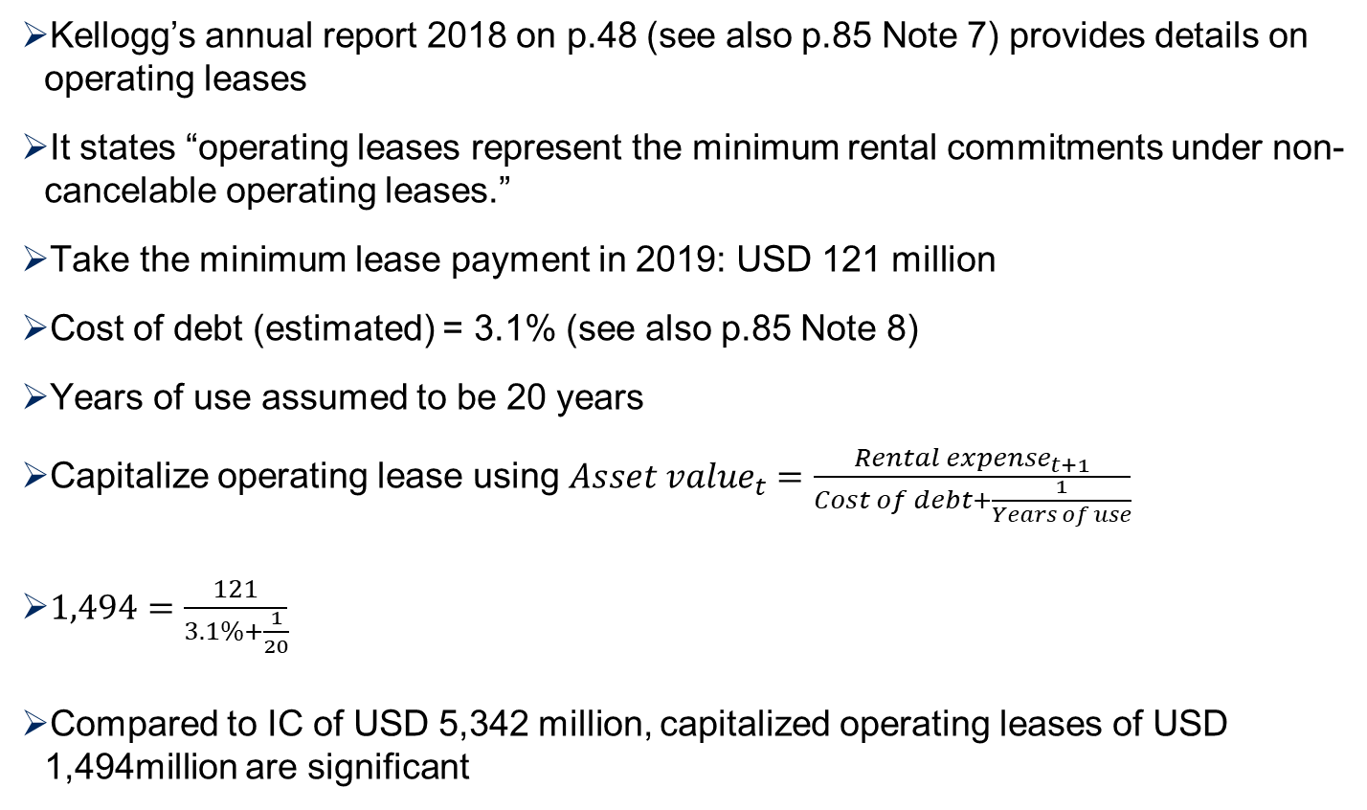
Let’s look at operating leases
Kellogg’s annual report 2018 on p.48 (see also p.85 Note 7) provides details on operating leases
It states “operating leases represent the minimum rental commitments under non-cancelable operating leases.”
Take the minimum lease payment in 2019: USD 121 million
Cost of debt (estimated) = 3.1% (see also p.85 Note 8)
Years of use assumed to be 20 years
Capitalize operating lease using${Asset value}_{t}=\frac{{Rental expense}_{t+1}}{Cost of debt+\frac{1}{Years of use}}$
$1,494=\frac{121}{3.1\%+\frac{1}{20}}$
Compared to IC of USD 5,342 million, capitalized operating leases of USD 1,494million are significant

Slide 30
Adjustment of invested capital and debt
In 2018, the capitalized operating leases of USD 1,494 million needs to be added to invested capital in 2018 of USD 5,342 million
In earlier years, one could check all annual reports to determine next year’s minimum lease payment which is time-consuming
Alternatively, the ratio of capitalized operating leases / invested capital of 28% in 2018 can be used to ‘backcast’ capitalized operating leases
This assumes that the lease policy has not changed in the last years
Debt has to increase in line with the capitalized operating leases of USD 1,494 million in 2018 and ‘backcasted’ capitalized operating leases

Slide 31
Separating deprecation and implied interest payments
We obtain implied interest expenses using USD 1,494 million× 3.1%=USD 46 million
Hence, the remaining amount is depreciation, i.e. USD 121 million - USD 46 million = USD 75 million
The implied interest expenses are added back to EBIT and interest expenses are increased by the implied interest expenses
The changes are minor in the case of COGS but interest expenses do increase considerably
These changes might affect the financial health of the company which we will discuss later
These adjustments also affect NOPLAT and adjusted net income, which in turn affects the accumulation of predicted equity through retained earnings

Slide 32
Impact on WACC and value of equity
As debt increases, WACC is reduced which partly offsets higher IC and hence lower asset efficiency
WACC is 4.0% down from 4.2% which increases the present value of future free cash flows
The entity value increases but a higher amount of debt (including capitalized operating leases) is deducted
However, the value of equity is hardly affected
The fundamental share price before adjustment is USD 69.9, which declines slightly to USD 69.5 after accounting for operating leases

Slide 33
BUT the impact on ROIC is high important for benchmarking

Slide 34
MAIN INSIGHTS
Operating leases
Impact on ROA and other measures
Capitalizing operating leases
Separating implied interest expenses and depreciation
Pensions
Net pension liability as a debt equivalent deducted from entity value
Only service cost is operating
Provisions
Income smoothing
Non-recurring items
Impact on value drivers important for benchmarking (see next lecture)

